Slide 1
Capstone project: Meezy cutz
Kierra McCallum, Ayman Ibrahim, Zack Munford

Slide 2
Purpose
Allow barber to manage and communicate with customers
Allow business to become more prominent by getting the company on the internet.
Allow better time management via appointment system
Display photo catalog of previous work done by Meezy Cutz.
Show location of shop and driving directions to customers who are not sure of the location
Allow customers to ask questions or concerns about the website or the business via email system.
Achieve more business via social media.

Slide 3
Key Functional Requirements
Create Account
Customer schedule appointment
Verify user
Admin login
Manage user accounts

Slide 4
Main User Interfaces

Slide 5
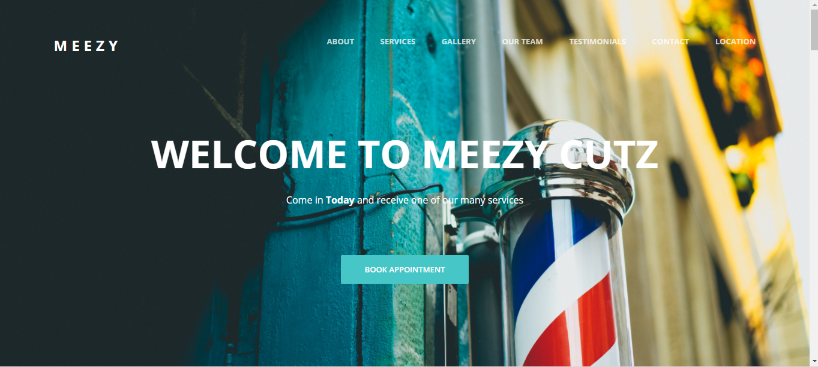
Home page

Slide 6
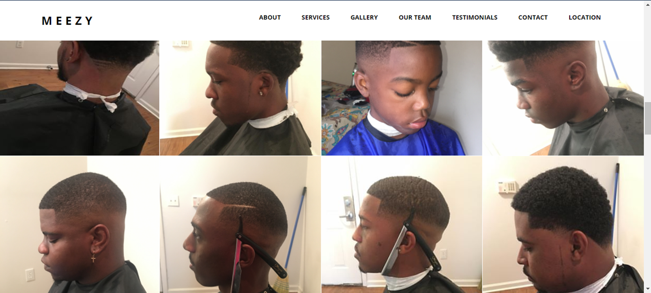
Gallery

Slide 7
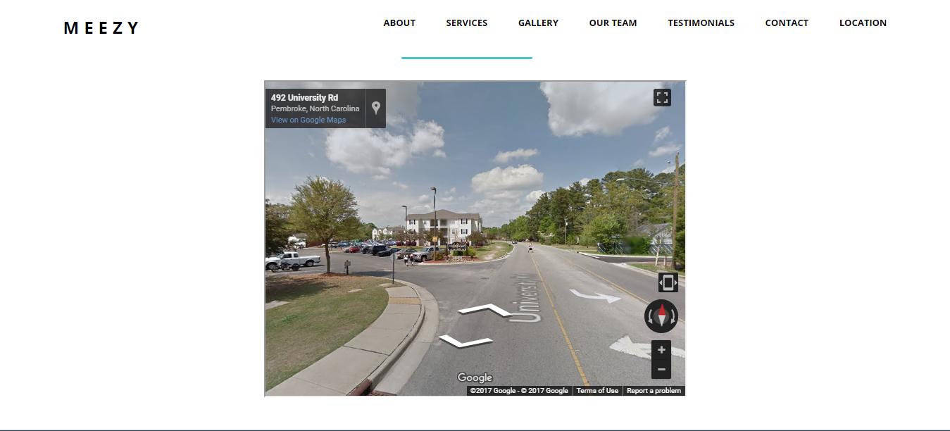
Google Maps

Slide 8
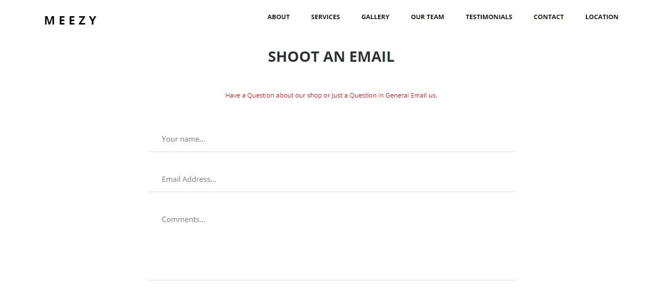
Email System

Slide 9
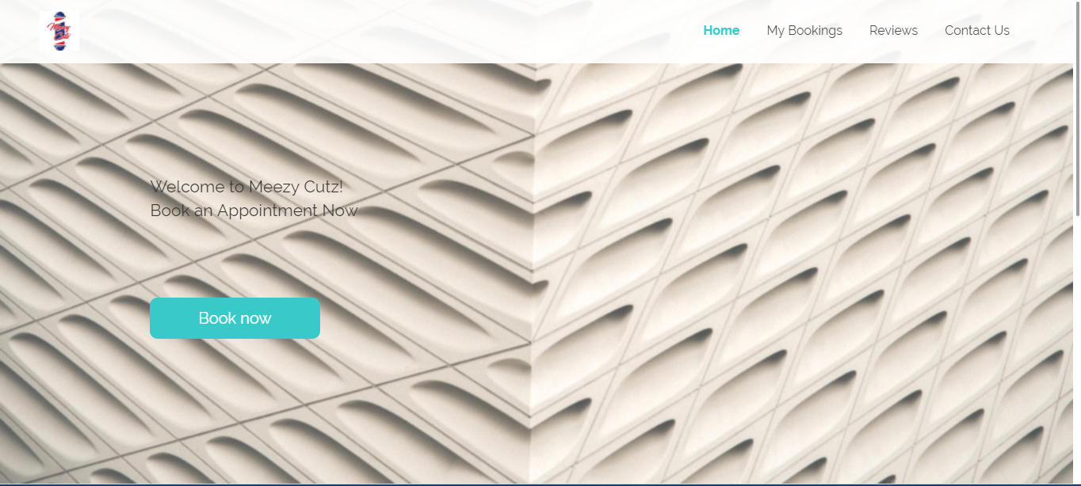
Appointment System

Slide 10
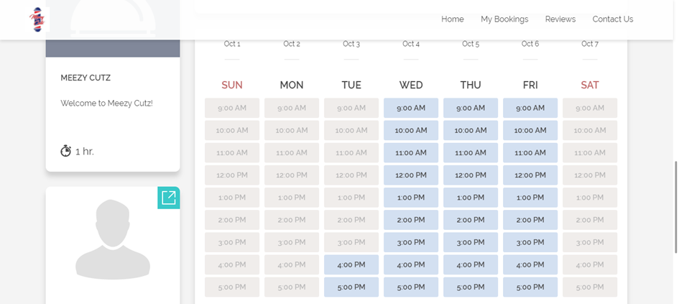
Appointment System

Slide 11
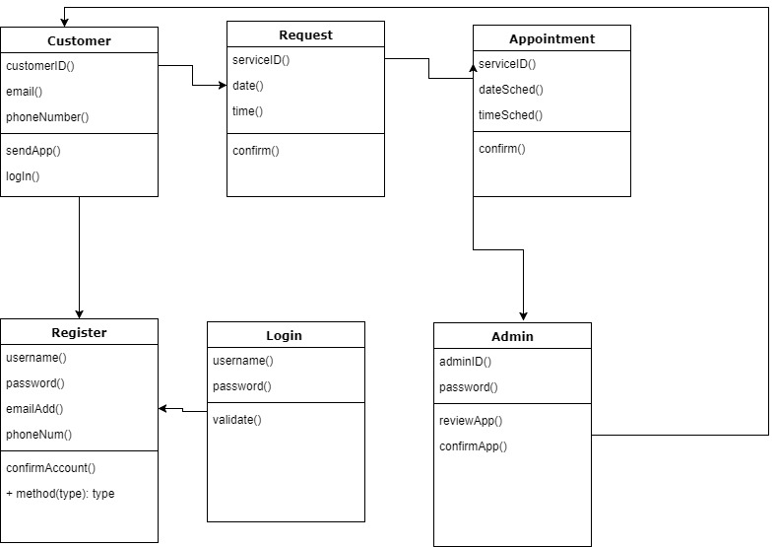
Class Diagram

Slide 12
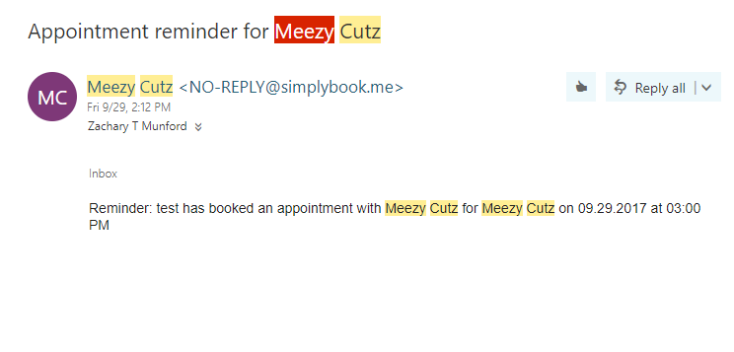
Test Cases

Slide 13
The End

